Slide 1

Uncertainty maps in medical imaging segmentation: state of the art
wILLIAm bassolino

Slide 2

papers in this review:
SkiNet: A deep learning framework for skin lesion diagnosis with uncertainty estimation and explainability – Singh et al. 2022
Aleatoric uncertainty estimation with test-time augmentation for medical image segmentation with convolutional neural networks – Wang et al. 2019
Exploring uncertainty measures in convolutional neural network for semantic segmentation of oral cancer images – Song et al. 2022
Inherent Brain Segmentation Quality Control from Fully ConvNet Monte Carlo Sampling – Roy et al. 2018
Uncertainty Driven Pooling Network for Microvessel Segmentation in Routine Histology Images – Fraz et al. 2018
MILD-Net: Minimal Information Loss Dilated Network for Gland Instance Segmentation in Colon Histology Images – Graham et al. 2018
Leveraging Uncertainty Estimates for Predicting Segmentation Quality – DeVries et Taylor 2018
ADNet++: A few-shot learning framework for multi-class medical image volume segmentation with uncertainty-guided feature refinement – Hansen et al. 2023
A Quantitative Comparison of Epistemic Uncertainty Maps Applied to Multi-Class Segmentation – Camarasa et al. 2021

Slide 3
Macro-topics
Uncertainty estimation in binary segmentation
Papers: 1-7
Uncertainty estimation in multi-class segmentation
Paper: 9
Uncertainty as method to improve segmentation
Papers: 3,5,6,8
Personal notes:
1. The use of entropy on both test-time data augmentation and Monte Carlo dropout samples to measure uncertainty is something that exists in literature. There is variety of approaches.
2. The question “how to transform the uncertainty map into a single metric?” is an open question, but the first papers have found maybe the best answer (accuracy of the prediction depending on the certainty)
3. Uncertainty estimation in multi-class segmentation is not a topic with extensive literature, but it exists.
4. The main methods to use uncertainty to improve segmentation are to have manual assistance from a domain expert, use it to fine tune model-specific features, or use uncertainty to remove uncertain pixels-voxels to improve performances.
5. Assuring segmentation quality without a test-set is still an open question in literature.
In the next slides, most important aspects of 9 papers are exposed.

Slide 4
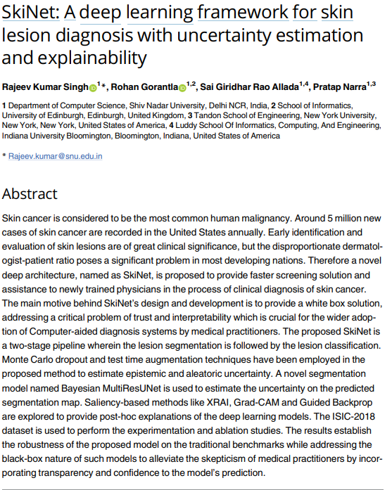
In-depth analysis: [1]
Abstract
The proposed SkiNet is a two-stage pipeline wherein the lesion segmentation is followed by the lesion classification.
A novel segmentation model named Bayesian MultiResUNet is used to estimate the uncertainty on the predicted segmentation map. Saliency-based methods like XRAI, Grad-CAM and Guided Backprop are explored to provide post-hoc explanations of the deep learning models.
Aleatoric vs epistemic uncertainty
There are mainly two types of uncertainty visualization, Aleatoric and Epistemic uncertainty:
Aleatoric uncertainty captures noise inherent in the data and cannot be abated by collecting more data.
Epistemic uncertainty, also known as model uncertainty, accounts for variability in the parameters of the model and analyzes what the model is not aware owing to the lack of training data. Epistemic uncertainty is helpful to understand examples that vary from training data especially in situations where we have small and imbalanced datasets, which is common in CAD systems.
Uncertainties are formulated as probability distributions over the model parameters (for
epistemic uncertainty) or model inputs (for aleatoric uncertainty).
SkiNet: A deep learning framework for skin lesion diagnosis with uncertainty estimation and explainability – Singh et al. 2022

Slide 5


Aleatoric uncertainty
A test sample s* is augmented to form V different versions of the image and is forwarded to the network. The mean μ_{a} over these iterations is considered the final result of a given test sample. μ_{a} is computed as shown in the equation:
where s*_{v} denotes the v^{th} augmented image, W denotes the weights of the network and V is the total number of image augmentations. Among several classes y* , the one with μ_{max} is selected as the outcome for each test sample s*.
Epistemic uncertainty
Given a test sample s* , we sample the network B times over its parameters and thereby giving an estimate of the predictive posterior distribution. The mean μ_{e} over these iterations is considered as the final result on a given test sample. μ_{e} is computed as shown in the equation:
where W_{B} denotes the weights of the network with dropouts in B^{th} MC iteration and B is the total number of sampled sets of weights. Among several classes y*, the one with μ_{max} is selected as the outcome for each test sample s*.
SkiNet: A deep learning framework for skin lesion diagnosis with uncertainty estimation and explainability – Singh et al. 2022

Slide 6


uncertainty
The two approaches are then combined to calculate the overall uncertainty where a test sample s* is augmented to form M different versions of the image and is forwarded to the network with the dropout activated during the test time. The mean μ over these iterations is considered as the final result on a given test sample. μ is computed as shown in the equation:
where s*_{m} denotes the augmented image passed and W_{m} denotes the weights of the network with dropouts during the m^{th} iteration and M is the total number of iterations. Among several classes y*, the one with μ_{max} is selected as the outcome for each test sample s*
In order to estimate the model uncertainty φ, we calculate the entropy of the averaged probability vector across the N classes using the equation
where p_{n} is the probability of n^{th} class
SkiNet: A deep learning framework for skin lesion diagnosis with uncertainty estimation and explainability – Singh et al. 2022

Slide 7


Evaluation METRICS: UNCERTAINTY
Normalized uncertainty φ_{norm} is calculated:
To split the predictions into certain and uncertain categories, we set a threshold φ_{T} [0, 1] where a prediction is deemed to be certain if φ_{norm} < φ_{T} and uncertain if φ_{norm}
There are 4 kinds of predictions:
Incorrect-uncertain (iu) → prediction is incorrect and the model is uncertain about it
correct-uncertain (cu) → prediction is correct but the model is uncertain about it
correct-certain (cc) → prediction is correct and the model is uncertain about it
incorrect-certain (ic) → prediction is incorrect and the model is certain about it
Diagnostic Accuracy A is represented in the form:
where L represents the count of each possible combination
SkiNet: A deep learning framework for skin lesion diagnosis with uncertainty estimation and explainability – Singh et al. 2022

Slide 8
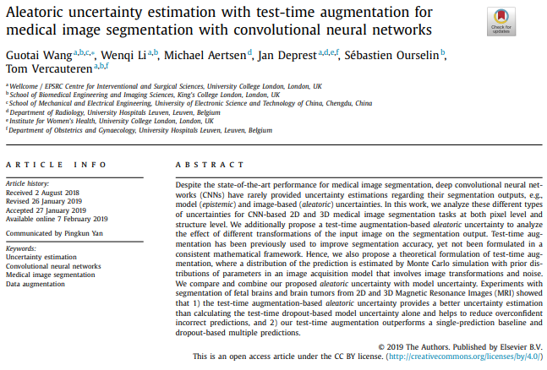

In-depth analysis: [2]
Test-time augmentation
We propose a more general estimation of aleatoric uncertainty that is related to not only
image noise but also spatial transformations (rotation, scaling, flipping) of the input, considering different possible poses of the object during image acquisition. To obtain the transformation-related uncertainty, we augment the input image at test time, and obtain an estimation of the distribution of the prediction based on test-time augmentation.
We propose a mathematical formulation for test-time augmentation, and analyse its performance for the general aleatoric uncertainty estimation in medical image segmentation tasks.
Methods
Both the variance and entropy of the distribution p(Y|X) can be used to estimate uncertainty. However, variance is not sufficiently representative in the context of multimodal distributions. In this paper we use [Shannon] entropy for uncertainty
Estimation (both for aleatoric and epistemic uncertainties).
[Note: they use Monte Carlo sampling for Aleatoric Uncertainty estimation because they don’t apply inverse transformation to the perturbated images because they don’t know the paraemeters]
We use the volume variation coefficient (VVC) to estimate the structure-wise uncertainty
Aleatoric uncertainty estimation with test-time augmentation for medical image segmentation with convolutional neural networks – Wang et al. 2019

Slide 9
Experiments and results
We compared different types of uncertainties for the segmentation results:
the proposed aleatoric uncertainty based on our formulated test-time augmentation (TTA)
the epistemic uncertainty based on test-time dropout (TTD)
hybrid uncertainty that combines the aleatoric and epistemic uncertainties based on TTA + TTD
We also evaluated the segmentation accuracy of these different prediction methods: TTA, TTD, TTA + TTD and the baseline that uses a single prediction without TTA and TTD
Aleatoric uncertainty estimation with test-time augmentation for medical image segmentation with convolutional neural networks – Wang et al. 2019

Slide 10
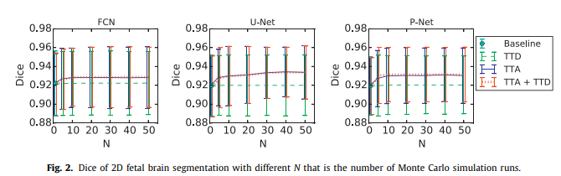
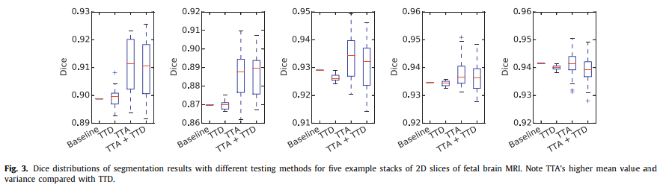
Plots and measures
N=20 was chosen →
← Plot that shows the dices distribution of the N different inferences on 5 different images
Aleatoric uncertainty estimation with test-time augmentation for medical image segmentation with convolutional neural networks – Wang et al. 2019

Slide 11
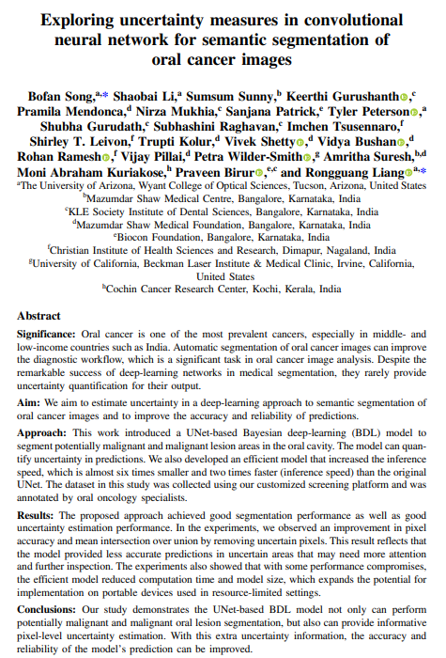

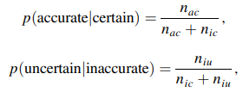

In-depth analysis: [3]
Uncertainty measure
This work introduced a UNet-based Bayesian deep-learning (BDL) model to segment potentially malignant and malignant lesion areas in the oral cavity. The model can quantify uncertainty in predictions.
The uncertainty is obtained by calculating the variance:
where p(y|x*,W_{i} ) represents σ times softmax output with different weights W_{i} of input x and p(y|x*,X,Y) is the predictive posterior mean of input x*.
Uncertainty evaluation
d two conditional probabilities as uncertainty evaluation metrics, p (accurate | certain) and p (uncertain | inaccurate), and the combination of them, patch accuracy versus patch uncertainty (PAvPU)
Exploring uncertainty measures in convolutional neural network for semantic segmentation of oral cancer images – Song et al. 2022

Slide 12
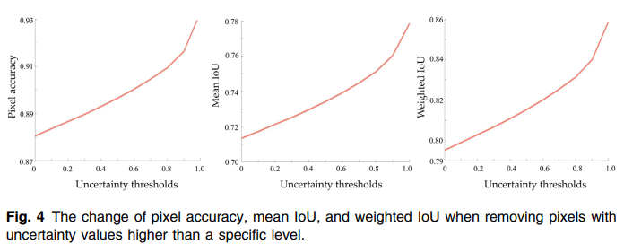
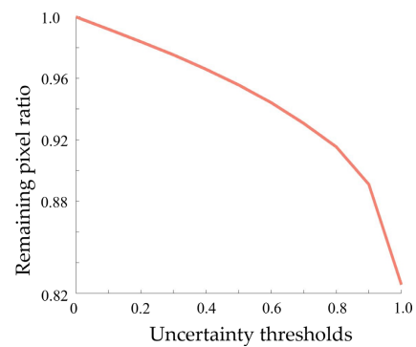
The idea is to better the segmentation performances by removing uncertain pixels
Experiments and results
We measured the change in pixel accuracy, mean IoU, and weighted IoU when removing pixels with uncertainty values higher than a specific level. By adjusting the level of uncertainty thresholding, we plotted the change of these three evaluation metrics in the following figure. We can see a continuous increase in all three evaluation metrics in response to a change in uncertainty thresholding.
The remaining pixel ratios (1—removed pixel ratio) corresponding to different uncertainty thresholds
Exploring uncertainty measures in convolutional neural network for semantic segmentation of oral cancer images – Song et al. 2022

Slide 13
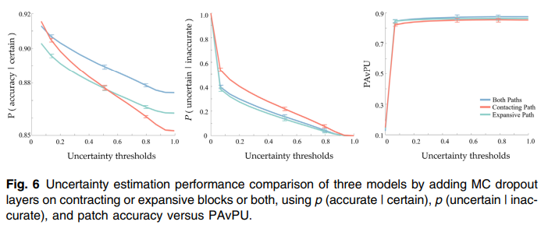
Experiments and results
To evaluate the uncertainty estimation performance, we calculated and compared the p (accurate | certain), p (uncertain | inaccurate), and PAvPU. We then observed how these metrics varied with a change of uncertainty threshold. A model with A higher value of these metrics is a better performer.
Exploring uncertainty measures in convolutional neural network for semantic segmentation of oral cancer images – Song et al. 2022

Slide 14
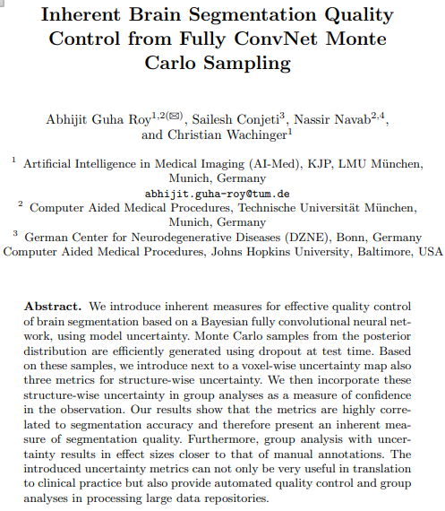



In-depth analysis: [4]
Abstract
We introduce next to a voxel-wise uncertainty map also three metrics for structure-wise uncertainty. We then incorporate these structure-wise uncertainty in group analyses as a measure of confidence in the observation. The metrics are highly correlated to segmentation accuracy and therefore present an inherent measure of segmentation quality. The introduced uncertainty metrics can not only be very useful in translation
to clinical practice but also provide automated quality control and group
analyses in processing large data repositories.
Uncertainty measures
Voxel-wise uncertainty → entropy over all N MC probability maps p_{S} : the voxel-wise uncertainty is the sum over all structures s
Structure-wise uncertainty → three different strategies:
Variation of the volume across the MC samples →
Overlap between samples, computing the average DICE score over all pairs of MC samples →
Mean voxel-wise uncertainty over the voxels which were labelled as s →
Inherent Brain Segmentation Quality Control from Fully ConvNet Monte Carlo Sampling – Roy et al. 2018

Slide 15
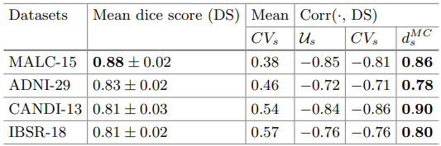
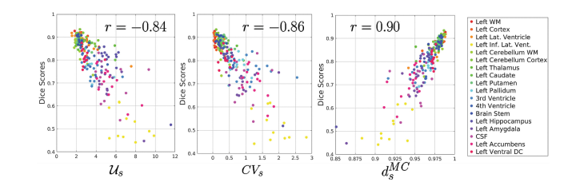
Quantitative analysis
We computed the correlation coefficient between the dice scores and the three types of structure-wise uncertainty.
The overall high correlation for d_{S}^{MC} indicates that it is suitable proxy for measuring segmentation accuracy without presence of ground truth annotations.
Scatter plot of three types of uncertainty and Dice scores on CANDI-13 dataset
(one dot per scan and structure), with their corresponding correlation coefficient (r).
For clarity, structures only on the left hemisphere are shown
Inherent Brain Segmentation Quality Control from Fully ConvNet Monte Carlo Sampling – Roy et al. 2018

Slide 16
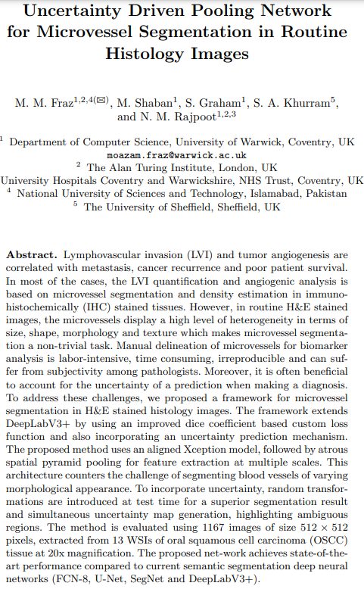
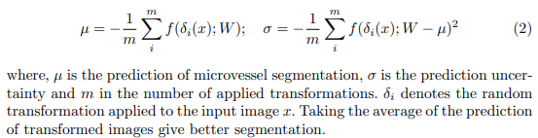
In-depth analysis: [5]
Abstract
We proposed a framework for microvessel segmentation in H&E stained histology images. To incorporate uncertainty, random transformations are introduced at test time for a superior segmentation result and simultaneous uncertainty map generation, highlighting ambiguous regions.
Uncertainty estimation
we present a framework for precise segmentation of microvessels in H&E stained histology images at multiple scales and resolutions by using an uncertainty aware spatial pyramid pooling deep neural network architecture.
Despite achieving state-of-the art performance in semantic segmentation, the deep networks typically do not inherently model the segmentation uncertainty. For this purpose, we apply random transformations to the images during test time, as a method to generate the approximate predictive distribution. Taking the average of these predictions of transformed images yields a superior segmentation and enables us to observe ambiguous areas, where the network is uncertain in a decision.
Transformations of the images comprehend median blur, Gaussian blur, rotation, flipping, Gaussian Noise.
Uncertainty is the variance within the samples:
Uncertainty Driven Pooling Network for Microvessel Segmentation in Routine Histology Images – Fraz et al. 2018

Slide 17
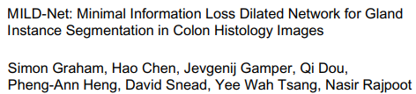
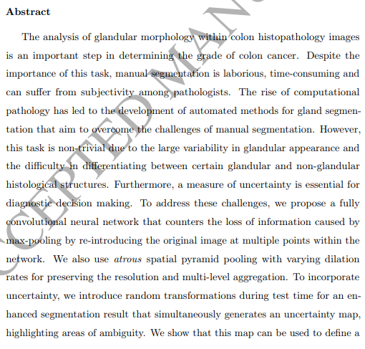
In-depth analysis: [6]
Abstract
To incorporate uncertainty, we introduce random transformations during test time for an enhanced segmentation result that simultaneously generates an uncertainty map,
highlighting areas of ambiguity. This map can be used to define a metric for disregarding predictions with high uncertainty.
Introduction
Uncertainty of a prediction and the simultaneous segmentation of additional histological components, may give additional diagnostic power.
During uncertainty quantification, we apply random transformations to the input images
as a method of generating the predictive distribution. This leads to a superior segmentation result and allows us to observe areas of uncertainty that may be clinically informative. Furthermore, we use this measure of uncertainty to rank images that should be prioritised for pathologist annotation.
MILD-Net: Minimal Information Loss Dilated Network for Gland Instance Segmentation in Colon Histology Images – Graham et al. 2018

Slide 18


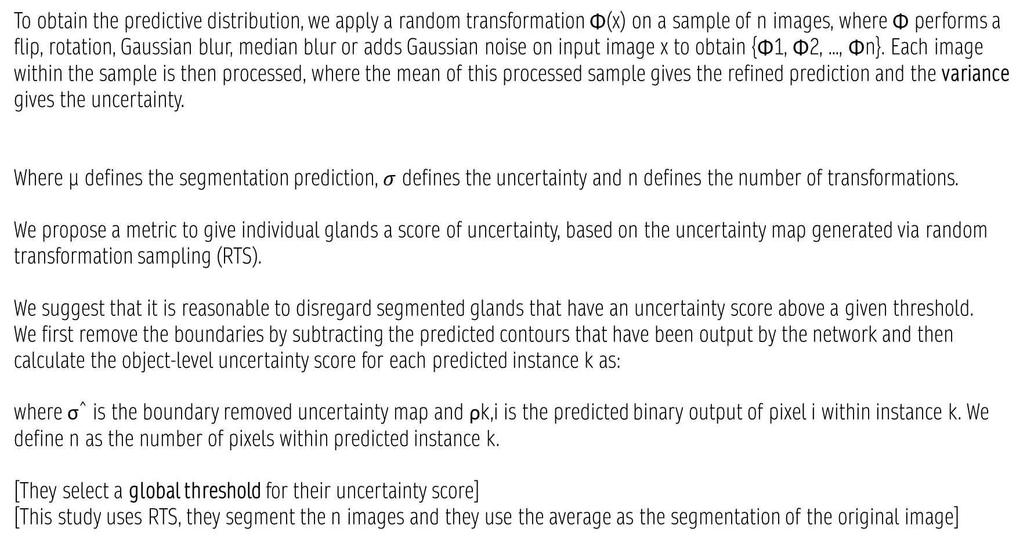
Random transformation sampling for uncertainty quantification
To obtain the predictive distribution, we apply a random transformation Φ(x) on a sample of n images, where Φ performs a flip, rotation, Gaussian blur, median blur or adds Gaussian noise on input image x to obtain {Φ1, Φ2, ..., Φn}. Each image within the sample is then processed, where the mean of this processed sample gives the refined prediction and the variance gives the uncertainty.
Where µ defines the segmentation prediction, $σ$ defines the uncertainty and n defines the number of transformations.
We propose a metric to give individual glands a score of uncertainty, based on the uncertainty map generated via random transformation sampling (RTS).
We suggest that it is reasonable to disregard segmented glands that have an uncertainty score above a given threshold.
We first remove the boundaries by subtracting the predicted contours that have been output by the network and then calculate the object-level uncertainty score for each predicted instance k as:
where σˆ is the boundary removed uncertainty map and ρk,i is the predicted binary output of pixel i within instance k. We define n as the number of pixels within predicted instance k.
[They select a global threshold for their uncertainty score]
[This study uses RTS, they segment the n images and they use the average as the segmentation of the original image]
MILD-Net: Minimal Information Loss Dilated Network for Gland Instance Segmentation in Colon Histology Images – Graham et al. 2018

Slide 19
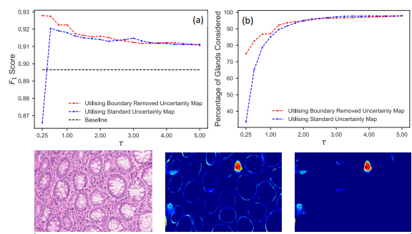
Random transformation sampling for uncertainty quantification
Object-level uncertainty quantification.
(a) shows the F1 score as we disregard
predictions with an uncertainty score τk greater than a given threshold τ.
(b) The percentage of total instances considered, given a threshold τ. For the red dashed line, we use the boundary removed uncertainty map, whereas for the blue dashed line we use the standard uncertainty map. The black horizontal line shows the F1 score when no glands with a high uncertainty are removed.
(c) from left to right: original image; uncertainty map σ; boundary removed uncertainty map σˆ. For each
instance k within σˆ, an object-level uncertainty score τ is calculated
Removing the boundary allows us to preserve a larger proportion of the dataset when we are using lower thresholds for the removal of predictions with high uncertainty: utilising the boundary removed uncertainty map is more robust and can be effectively used to select predictions with low uncertainty. The intuition of disregarding glands with high uncertainty means that we should not extract any statistical measures from these disregarded glands. Therefore, when removing predicted instances with high uncertainty, we also remove the corresponding ground truth instance to obtain the above measures
MILD-Net: Minimal Information Loss Dilated Network for Gland Instance Segmentation in Colon Histology Images – Graham et al. 2018

Slide 20
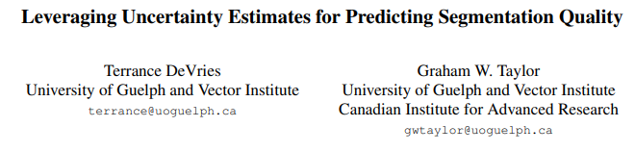
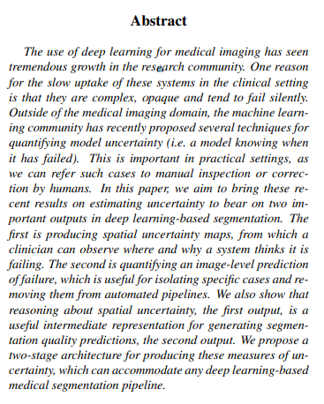

In-depth analysis: [7]
Abstract
Estimate uncertainty to bear on two important outputs in deep learning-based segmentation. The first is producing spatial uncertainty maps, from which a clinician can observe where and why a system thinks it is failing. The second is quantifying an image-level prediction of failure, which is useful for isolating specific cases and removing them from automated pipelines. We also show that reasoning about spatial uncertainty, the first output, is a useful intermediate representation for generating segmentation quality predictions, the second output..
Estimating segmentation quality with uncertainty information
The segmentation network takes in some image x, and produces two outputs: class prediction logits ρ and corresponding uncertainty (or confidence) estimates z (z is uncertainty map).
A second network g is then trained to predict the quality of the segmentation vˆ.
Segmentation quality measurement can be any segmentation-based evaluation metric, or
even multiple metrics predicted simultaneously.
In the case that f performs very well on the training set, a holdout set may be necessary, as the lack of examples of poor segmentations will bias g towards always predicting that the segmentation is good.
Uncertainty estimation
Model uncertainty z is estimated by calculating the entropy of the averaged probability vector across the class dimension:
Leveraging Uncertainty Estimates for Predicting Segmentation Quality – DeVries et Taylor 2018

Slide 21
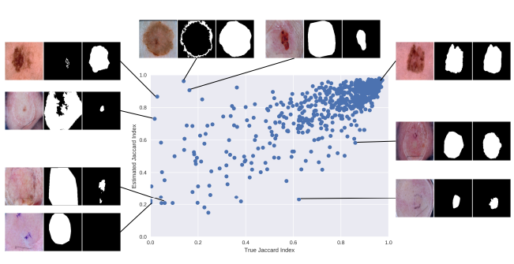
Segmentation quality prediction
We use a variety of metrics to evaluate how well our models can predict the quality of segmentations: RMSE, detection error, AUROC, and AUPR.
Leveraging Uncertainty Estimates for Predicting Segmentation Quality – DeVries et Taylor 2018

Slide 22
Segmentation quality prediction
Treating uncertainty explicitly improves performance significantly compared to the case with no uncertainty information.
segmentation quality estimates rarely fall below 0.2 for any method. This is likely caused by the rarity of poor quality segmentations in the dataset used to train the segmentation quality estimation network, since it was trained on the same dataset as the original segmentation network.
Conclusion: making spatial uncertainty explicit aided in predicting a measure of segmentation quality, the Jaccard index.
Leveraging Uncertainty Estimates for Predicting Segmentation Quality – DeVries et Taylor 2018

Slide 23
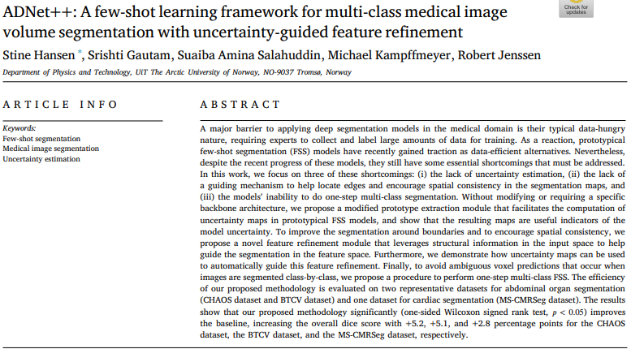
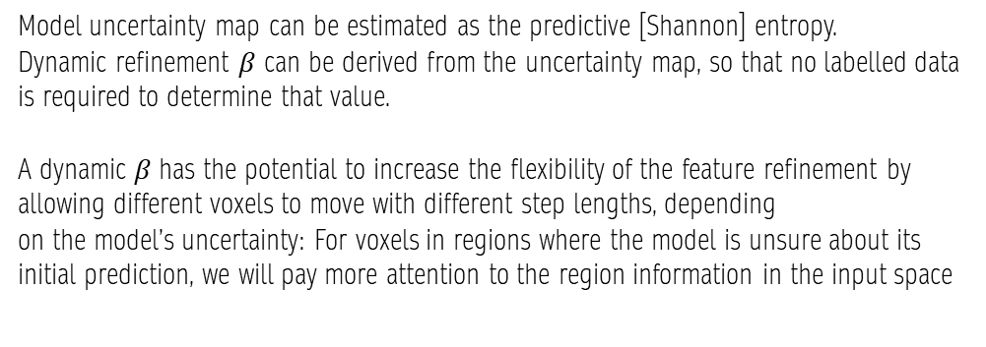
In-depth analysis: [8]
introduction
l few-shot segmentation (FSS) models have recently shown promise as data efficient alternatives to solving this task by using a small set of labeled examples to extract class-wise prototypes that can be leveraged to segment objects in new images.
existing medical FSS models do not provide any measure of uncertainty for their predictions.
Current medical FSS methods only focus on binary foreground/background segmentation and are forced to segment the images class-by-class.
To facilitate the computation of uncertainty maps in prototypical FSS models we propose a modified prototype extraction module that introduces a Bernoulli distributed variable for each voxel location in the feature representation. Uncertainty maps are then based on the predictive distribution estimated from a set of prototypes extracted by this proposed module: uncertainty maps can be used to automatically guide this
feature refinement.
Uncertain estimation and refinement module
Model uncertainty map can be estimated as the predictive [Shannon] entropy.
Dynamic refinement $β$ can be derived from the uncertainty map, so that no labelled data is required to determine that value.
A dynamic 𝛽 has the potential to increase the flexibility of the feature refinement by allowing different voxels to move with different step lengths, depending
on the model’s uncertainty: For voxels in regions where the model is unsure about its initial prediction, we will pay more attention to the region information in the input space
ADNet++: A few-shot learning framework for multi-class medical image volume segmentation with uncertainty-guided feature refinement – Hansen et al. 2023

Slide 24
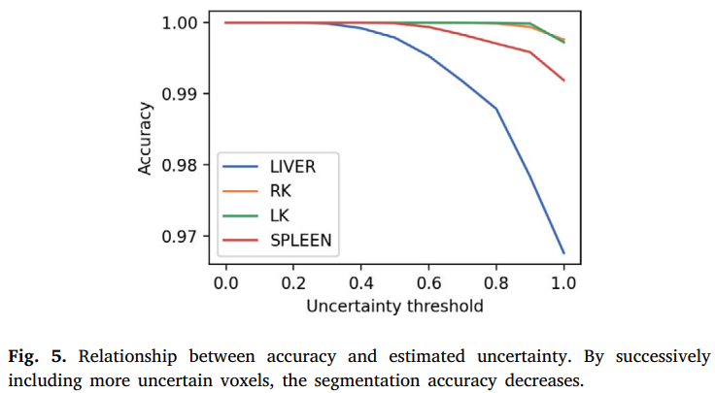
Uncertainty maps
to quantify the fidelity of the estimated uncertainty maps, we start by removing all voxels in the predictions and successively add voxels according to their estimated uncertainty, starting with the least uncertain voxels. Segmentation performance decreases for all classes as more uncertain voxels are included: uncertainty maps canbe used to quantify how much a prediction can be trusted.
ADNet++: A few-shot learning framework for multi-class medical image volume segmentation with uncertainty-guided feature refinement – Hansen et al. 2023

Slide 25
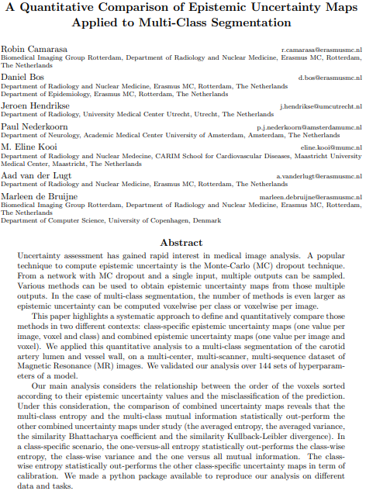
In-depth analysis: [9]
Abstract
Two different contexts: class-specific epistemic uncertainty maps (one value per
image, voxel and class) and combined epistemic uncertainty maps (one value per image and voxel).
Multi-class entropy and the multi-class mutual information statistically out-perform the
other combined uncertainty maps under study (the averaged entropy, the averaged variance, the similarity Bhattacharya coefficient and the similarity Kullback-Leibler divergence). In a class-specific scenario, the one-versus-all entropy statistically out-performs the class-wise entropy, the class-wise variance and the one versus all mutual information. The classwise entropy statistically out-performs the other class-specific uncertainty maps in term of calibration.
introduction
A multi-class segmentation task provide a larger set of epistemic uncertainty maps than a single-class segmentation task as it is possible to compute combined epistemic uncertainty maps (one uncertainty map per voxel, per image) or class-specific epistemic uncertainty maps (one uncertainty map per class, per voxel, per image).. there is limited
research focusses on analysing the extra options resulting from the multi-class setting.
systematic approach to characterize both class-specific epistemic uncertainty maps, combined epistemic uncertainty maps separating the epistemic uncertainty map into a uncertainty measure and an aggregation method
quantitatively and statistically compare the ability of those different epistemic uncertainty maps to assess misclassification on a segmentation of the carotid artery on a multi-center, multi-scanner, multi-sequence dataset of MR images
compare our evaluation of
class-specific epistemic uncertainty derived from the MC dropout technique to the one proposed in the BRATS challenge (Menze et al., 2014) in a multi-class segmentation setting
A Quantitative Comparison of Epistemic Uncertainty Maps Applied to Multi-Class Segmentation – Camarasa et al. 2021

Slide 26
Uncertainty analysis
In medical imaging, a straightforward approach is to consider the inter-observer variability as ”ground truth” aleatoric uncertainties.
quantifying uncertainty
To quantify the uncertainty of the prediction distribution per voxel, one can either determine the uncertainty of a class-specific prediction distribution, study the similarity between the different class-specific prediction distributions or directly determine the uncertainty of the prediction distribution.
DESCRIPTION MEASURES → uncertainty of a single class-specific prediction distribution. Examples are variance or entropy
SIMILARITY MEASURES → An approach to quantify the uncertainty is to measure the similarity of two class-specific prediction distributions (where c’ and c’’ are two distinct output classes). The more those two distributions overlap, the more similar they are and the more difficult it is to determine the predicted class, which makes the outcome more uncertain. Examples are Bhattacharya Coefficient (BC) and Kullback-Leibler Divergence (KL)
MULTI-CLASS MEASURES → capture the uncertainty of the prediction distributions in one measure of uncertainty. Examples: entropy of MC dropout distribution (entropy of the mean of the prediction distribution), Mutual Information (MI) between the MC dropout distribution over the model parameters.
A Quantitative Comparison of Epistemic Uncertainty Maps Applied to Multi-Class Segmentation – Camarasa et al. 2021

Slide 27



Aggregation methods
Now that the different uncertainty measures are defined, it is important to define the different aggregation methods to obtain the epistemic uncertainty maps from those measures of uncertainty. Two families: combined aggregation methods and class-specific aggregation methods.
Combined Aggregation methods
They use the description measure per voxel per class and average those descriptions per voxel over the classes.
AVERAGED AGGREGATION METHOD: where D is description measure (entropy or variance)
SIMILARITY AGGREGATION METHOD: where c1 and c2 are respectively the most and the second most probable classes of the voxel j and S is a similarity measure (BC or KL)
MULTICLASS DESCRIPTION MEASURE: where M is a multi-class measure (entropy or MI)
A Quantitative Comparison of Epistemic Uncertainty Maps Applied to Multi-Class Segmentation – Camarasa et al. 2021

Slide 28


Class-specific Aggregation methods
The most direct aggregation method to obtain an uncertainty map per class is to compute a description measure (either distribution variance or distribution entropy) per voxel per class.
This approach is the DESCRIPTION AGGREGATION METHOD:
Another approach is the ONE VERSUS ALL AGGREGATION METHOD:
That consists in the application of a multi-class measure to the distribution of the class under study and the sum of the distributions of the other classes.
A Quantitative Comparison of Epistemic Uncertainty Maps Applied to Multi-Class Segmentation – Camarasa et al. 2021

Slide 29
Combined evaluation
Considering uncertainty as a score that predicts misclassification leads to a redefinition of the notions of true and false positives and negatives in an uncertainty context. A voxel is considered misclassified when its predicted class and its ground truth class mismatch.
Once an uncertainty map is thresholded at a value τ_{u}, one can define four types of:
misclassified and uncertain (UTP(τu) in a sense that the uncertainty of the voxel accurately predicts its misclassification)
misclassified and certain (UFN(τu))
correctly classified and uncertain (UFP(τu))
correctly classified and certain (UTN(τu))
For a given value of the uncertainty threshold τ_{u}, it is possible to compute the precision and the recall of uncertainty as a misclassification predictor following:
The main characteristic of this performance measure is its independence from uncertainty map calibration. Only the order of the voxels sorted according to their epistemic uncertainty values matters as this performance measure is invariant by strictly monotonic increasing transformation.
A Quantitative Comparison of Epistemic Uncertainty Maps Applied to Multi-Class Segmentation – Camarasa et al. 2021

Slide 30

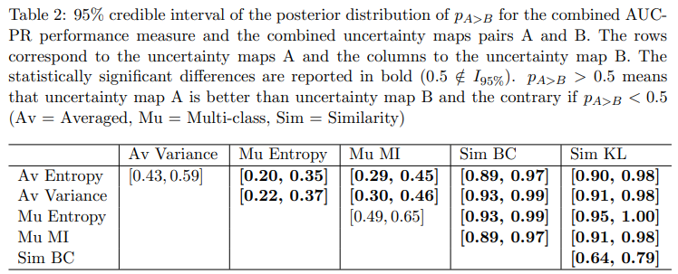
Class-specific evaluation
For each filtering threshold τf , the voxels with uncertainty values in the uncertainty map u above the threshold τf are removed from the prediction. Then, one can derive the ratio of filtered true positives (tpr(τf )), the ratio of filtered true negatives (tnr(τf )) and the filtered Dice score (Dice(τf )). The BraTS uncertainty performance measure (BRATS-UNC) integrates these three measurements over the range of values of the uncertainty map, as follows:
BRATS-UNC is slightly altered compared to its original formulation by Mehta et al. (2020) to generalise to the case of
non-normalised uncertainty maps.
Statistical significance →
Combined uncertainty maps evaluation
Statistically significant best
results are observed with the multi-class entropy and the multi-class mutual information.
The statistically significant worst result is observed with the similarity KL
A Quantitative Comparison of Epistemic Uncertainty Maps Applied to Multi-Class Segmentation – Camarasa et al. 2021

Slide 31
discussion
Multi-class entropy and multi-class mutual information statistically out-perform the averaged variance and the averaged entropy which in turn statistically out-perform the similarity BC which out-performs the similarity KL. This analysis highlights the good performances of the multi-class aggregation method and the averaged aggregation method compared with the similarity aggregation method which is coherent with their extensive use in the literature. The superiority of the multi-class aggregation method over the class-wise aggregation method seems also coherent as the averaged aggregation
method consists of a combination of class-specific uncertainty maps where the multi-class aggregation method is designed for multi-class problems.
The entropy uncertainty measure out-performs the other uncertainty measures with a multiclass aggregation method in a combined scenario and with a one versus all aggregation method in a class-specific scenario.
In this article, we proposed a systematic approach to characterize epistemic uncertainty maps that can be used in a multi-class segmentation context. We also proposed a methodology to analyse the quality of multi-class epistemic uncertainty maps.
A Quantitative Comparison of Epistemic Uncertainty Maps Applied to Multi-Class Segmentation – Camarasa et al. 2021

Slide 32

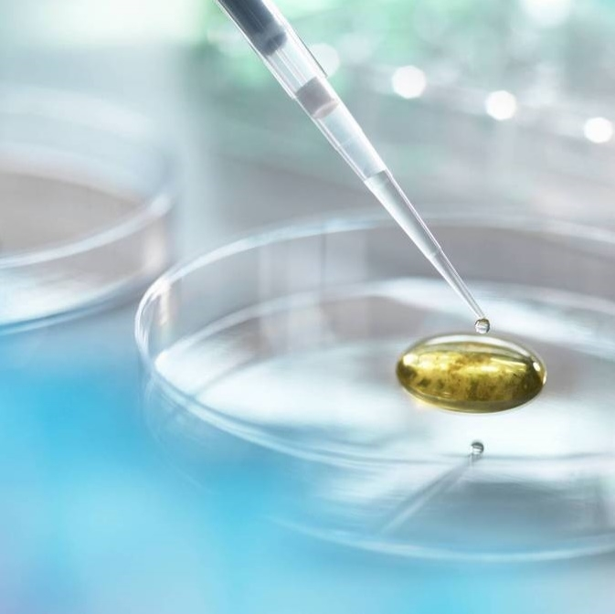
Grazie
William Bassolino

